Slide 1

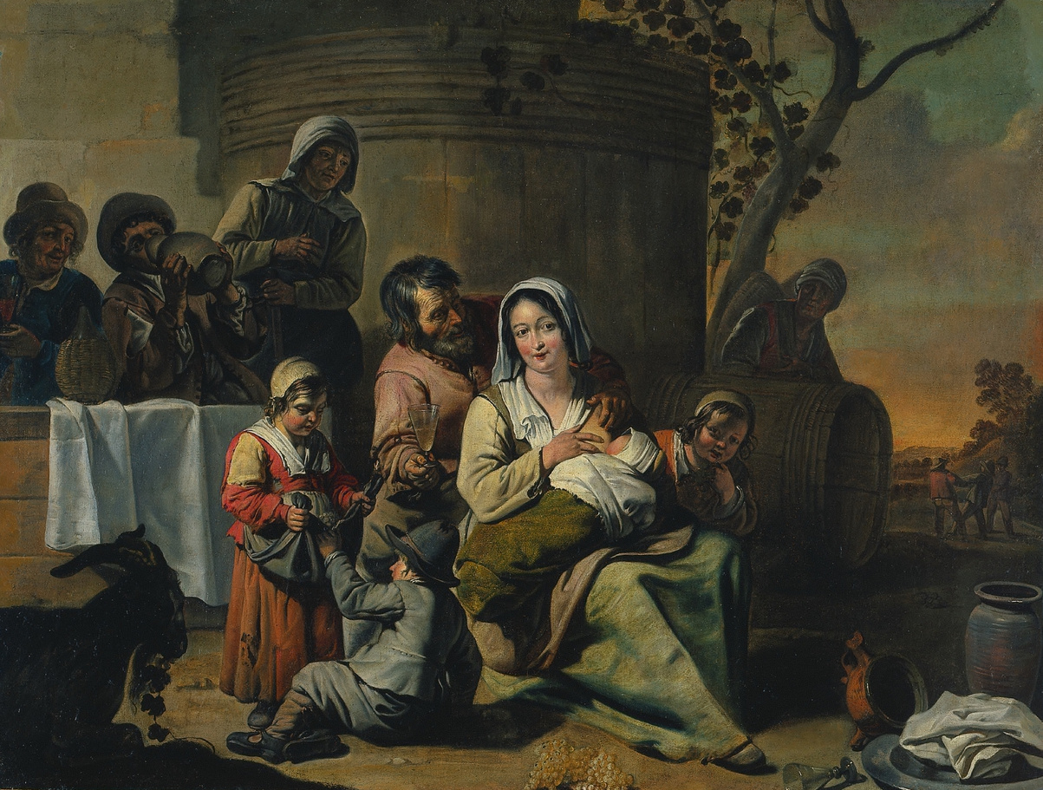
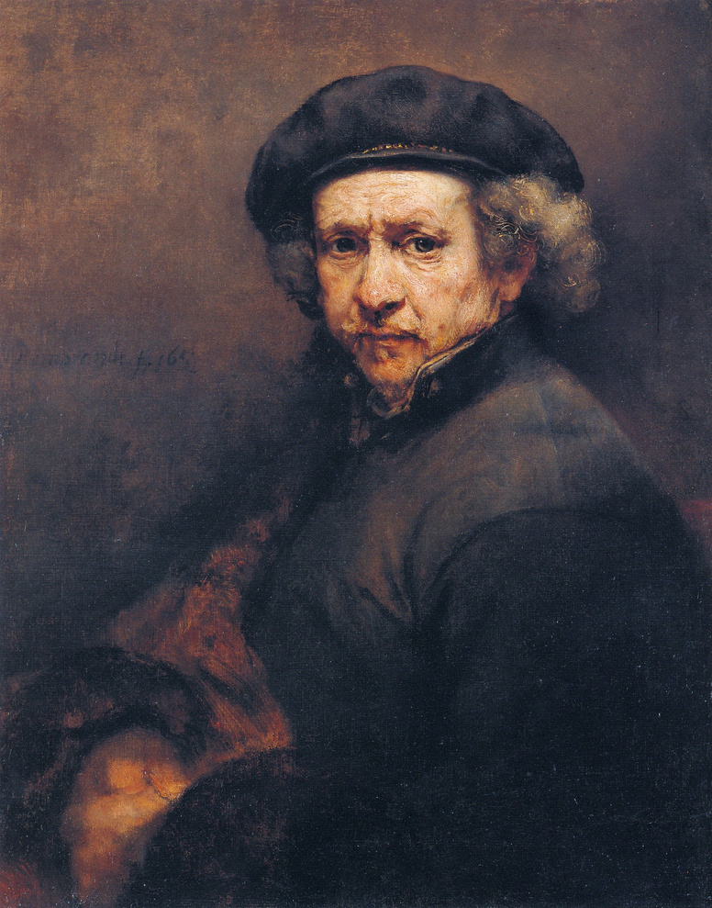
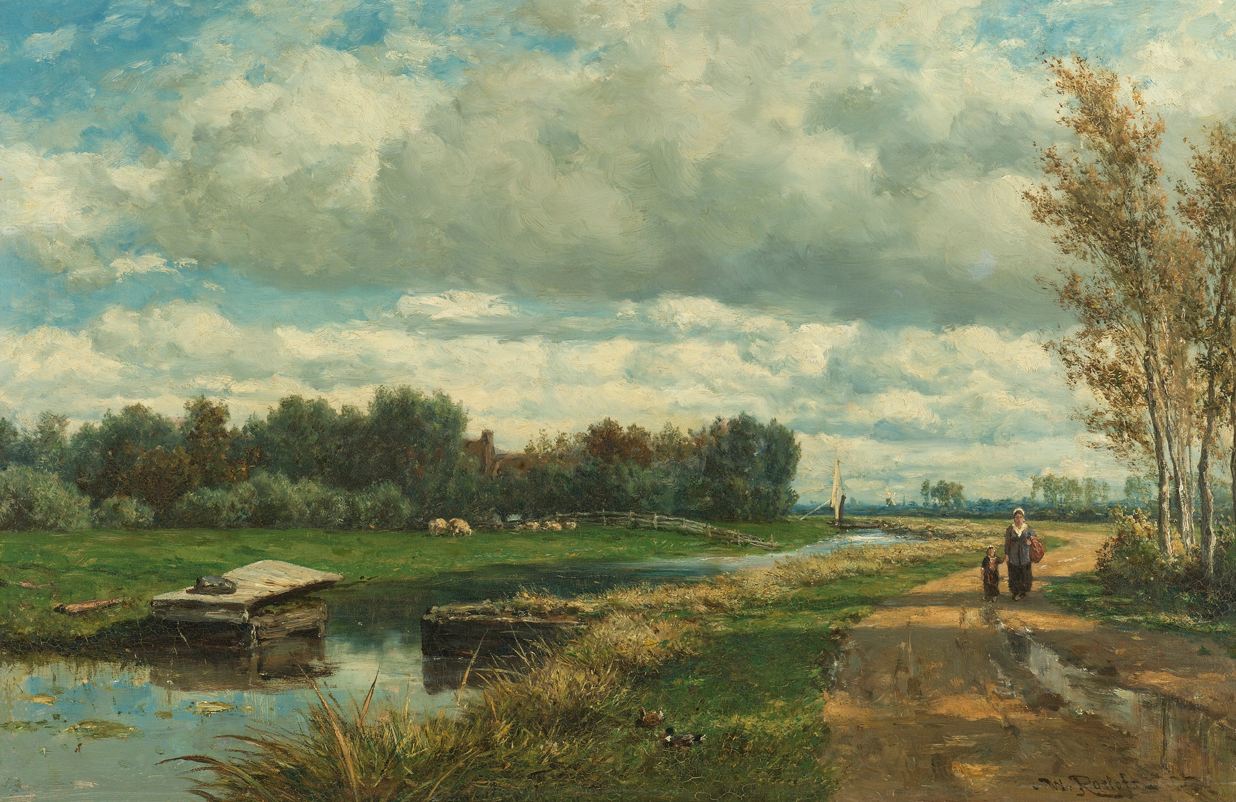

SQL PAINTINGS
CASE STUDY
Presented by: Pranavi Pulipaka
May, 2024

